Slide 1
DG Stowage & Segregation for Container ships
1-Particular caution is to be exercised when stowing dangerous cargo on board
the vessel.
Any dangerous cargo presented for loading must be accompanied by a
proper manifest and declaration as required by international regulations .
2-Further this DG cargo must be acceptable for carriage as per IMDG code guidance.
Reference here is made to the list of UN numbers restricted/prohibited for carriage
on board particular vessels.
3-After confirming acceptability of the DG cargo, the plan must be checked for
proper stowage and segregation. Although terminal and central planners should
provide proper stow of DG cargo, the final responsibility always lies with the Master.
4-Reference shall be made to vessels Document of Compliance with special
requirements for ships carrying dangerous goods for confirming that proposed DG
classes are acceptable for stowage in planned locations on board.

Slide 2
5-Specific stowage requirements for DG cargo (e.g. Clear of living quarters OR if under deck, in a mechanically ventilated space etc)
may be verified from individual entries of dangerous goods list in the IMDG code.
6-DG segregation shall be verified for compliance with requirements of the IMDG code.
Caution must be exercised when using vessels stowage planning software for this
purpose as it may or may not have comprehensive means of checking for bad
stowage & segregation against the latest international requirements.
It is advisable to manually check for compliance.
Segregation requirements of the IMDG code and any other local/national regulations
must be strictly adhered to. One must be aware that even DG cargoes belonging to the same class may have
segregation requirements amongst them.
A good example is that of alkalis requiring to be separated form acids where as both
acids and alkalis may belong to IMO Class 8. Such segregation requirement will not
be found in the segregation tables of the IMDG code and only individual entries of the
dangerous goods list in the code indicate the requirement

Slide 3
Case study on the port of Tianjin explosion
Operations at two container terminals in the port of Tianjin have been suspended following the massive blast at the dangerous goods warehouse.
Three other container terminals all located between 3 to 8 miles from the latter Tianjin facility
where the explosion occurred were confirmed to have been shut down immediately
The explosions of the dangerous materials were located in the Bonded Area of Tianjin port
and caused by a badly stored shipment of explosives of 24 tons of TNT.
THE CONSEQUENCES ARE
- 52 people were killed 40 on terminal +12 fire fighter
-700 people injured and intoxicated by the fumes of the toxic cloud
-Several thousands of cars were completely destroyed
-Series of containers were also destroyed
-The goods that were in the containers were also completely destroyed
-Buildings were damaged and destroyed
-The terminal equipment has been declared total loss
-It also caused a environmental problem because of the fumes that
were dangerous for human life when inhaled.
-Some of the container vessels that were on the terminal also were damaged
All the parties involved will now be very concerned on how the claims will be settled.
The carriers-shippers-owners of the cargo are very concerned about the whole situation which will cause a situation where a record amount of multi million dollar claims which will need to be settled over a period of several years.

Slide 4
THE REASONS THE CASTROPHY
1-Badly stored sodium cyanide 700 tons highly flammable and very dangerous
2-When the first explosions occurred
-It was unclear what chemicals were kept on site
-Officials panicked and did not have the lists handy on what
products and IMCO classes were stored on site.
-There was a high degree of panic, people did not know what to do
3-The documentation of the warehouse concerned the dangerous goods was
not kept up to date and was not available to the fire fighters or the authorities
4-The port and terminal were not prepared enough to confront a major incident
like this and did not have access quickly enough to the data and equipment
to be able and contain or reduce the impact of the situation.
5-Chemical experts were sent to assess the scene they could not be informed
about the other range of chemical products that were stored and could not evaluate if the mix of products could trigger a serial explosion or not and
what the immediate consequences would be for human life.

Slide 5
THE LESSONS
1-Train your staff and workers in the CFS and on the terminal
2-Follow the international guidelines IMDG-IMCO
3-Organize and plan the segregation in the CFS and Terminal and issue strict and
procedures and maintain them by controlling regularly if these are maintained.
4-Keep the data of the type of DG products of the CFS warehouse at close range and
insist that there is a second stock report and lay out of the segregation plan
on hand outside the CFS and terminal.
5-Make sure that there is sufficient fire fighting equipment and medical supplies
that are close to the area’s where the DG is stored and are immediately available.
6-Also put IMDG signs and warning placards on the doors and walls of the CFS and
on certain terminal area’s where DG are kept in containers.
7-Insist on the fact that one does not allow any cargo on terminal or CFS without
having detailed information on the content of the trucks or containers.
8-Pay attention to containers that arrive at your terminals in damaged condition
or have leakage or are without valid ACEP or CSC plates.
9-Hold regular training exercises.
10-Also link up with the hospitals and authorities that are in the vicinity of your area
and operations and also try to involve these during the training sessions.

Slide 6
DG Stowage & Segregation for Container ships
1-Particular caution is to be exercised when stowing dangerous cargo on board
the vessel.
Any dangerous cargo presented for loading must be accompanied by a
proper manifest and declaration as required by international regulations .
2-Further this DG cargo must be acceptable for carriage as per IMDG code guidance.
Reference here is made to the list of UN numbers restricted/prohibited for carriage
on board particular vessels.
3-After confirming acceptability of the DG cargo, the plan must be checked for
proper stowage and segregation. Although terminal and central planners should
provide proper stow of DG cargo, the final responsibility always lies with the Master.
4-Reference shall be made to vessels Document of Compliance with special
requirements for ships carrying dangerous goods for confirming that proposed DG
classes are acceptable for stowage in planned locations on board.

Slide 7
5-Specific stowage requirements for DG cargo (e.g. Clear of living quarters OR if under deck, in a mechanically ventilated space etc)
may be verified from individual entries of dangerous goods list in the IMDG code.
6-DG segregation shall be verified for compliance with requirements of the IMDG code.
Caution must be exercised when using vessels stowage planning software for this
purpose as it may or may not have comprehensive means of checking for bad
stowage & segregation against the latest international requirements.
It is advisable to manually check for compliance.
Segregation requirements of the IMDG code and any other local/national regulations
must be strictly adhered to. One must be aware that even DG cargoes belonging to the same class may have
segregation requirements amongst them.
A good example is that of alkalis requiring to be separated form acids where as both
acids and alkalis may belong to IMO Class 8. Such segregation requirement will not
be found in the segregation tables of the IMDG code and only individual entries of the
dangerous goods list in the code indicate the requirement

Slide 8
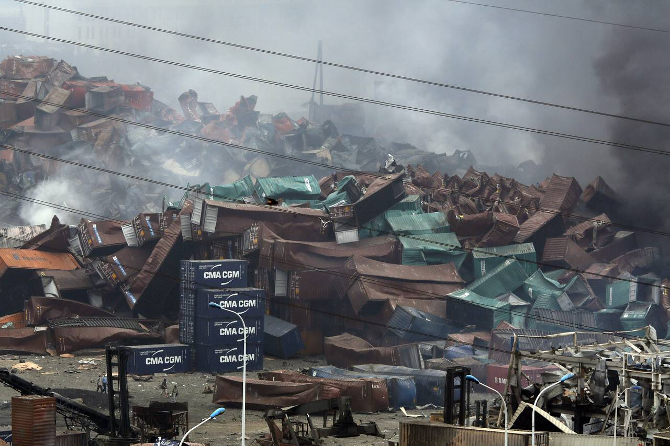

Slide 9
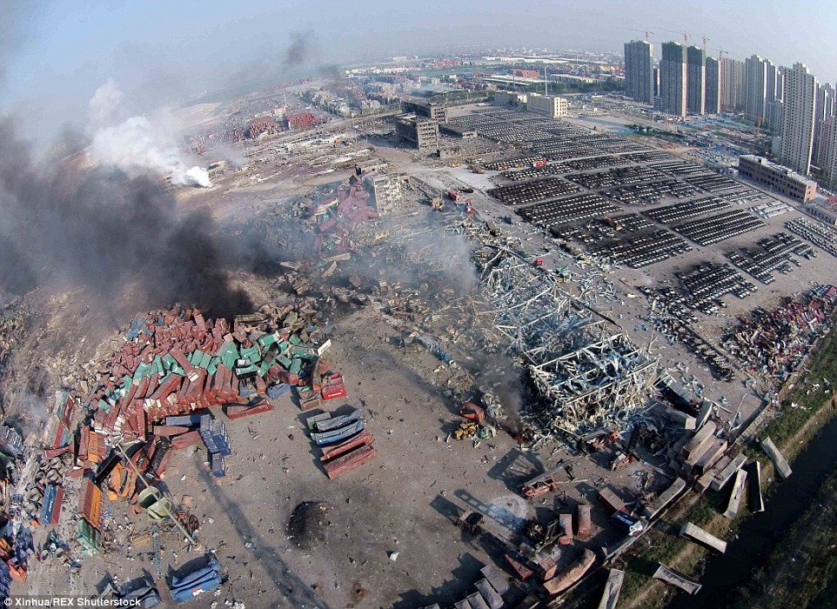

Slide 10
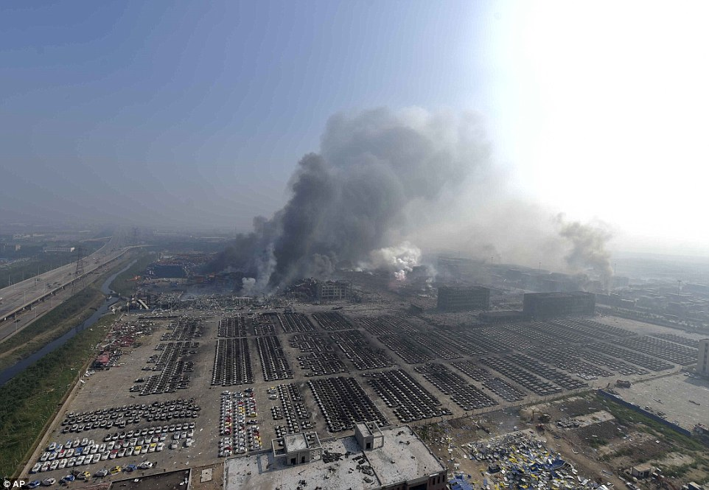

Slide 11
The MSC FLAMINIA INCIDENT
The 300 meter ship had been on its way from Charleston in the United States to the German
port of Bremerhaven after stops in Felixstowe, Suffolk, and Antwerp in Belgium.
An explosion occurred on the ship on July 14, about 300 nautical miles off the British coast, resulting in the death of one crew member while another remains missing.
The 23 people on board abandoned the ship and were picked up by an oil tanker.
German authorities have said the ship had 2,876 containers on board at the time of the explosion, of which 151 held flammable cleaning fluids.
The stricken MSC Flaminia, described as a “floating bomb”, has been burning for seven weeks in the Atlantic Ocean after an explosion left a crewman dead and caused extensive damage to the vessel.
It was due to be towed to Germany after limping around international waters since early July.
After it was established that there were 149 containers on board the 86,000 ton vessel that were classed as hazardous, corrosive or flammable it was clear that the number of the containers with dangerous goods seems to be unusually high and that many of them were classed generally
as NOS – NOT OTHERWISE SPECIFIED which meant that little or no correct and complete
DG information was made available to the terminal and the vessel that loaded the containers.
Among its contents were liquid polychlorinated biphenyls [PCBs], the pesticide isopropyl amine, nitromethane, a very explosive fuel,phosphorus,liquid amines and sodium.
Having all these chemicals on board the vessel became a toxic and dangerous floating bomb.
No wonder that the EU countries in the incident area feared the MSC Flaminia because she was just short of being an explosive nuclear device.

Slide 12
Initially the British authorities had refused to allow Dutch, British and Italian tug skippers to tow
The vessel through British coastal waters until such a time an assessment was completed on board
of the vessel to examine the “hot spots in the holds” by an international six-man team of inspectors.
It became clear that there were 37 containers on board the ship that could be a serious risk for the environment and together with the 1,247 tons of heavy crude oil and 680 tons of diesel on board the accident was potentially an enormous environmental disaster.
The authorities of the neighboring countries and the environmental groups have expressed outrage
at the slowness of the response and actions to this emergency situation but this was due to the fact that one firstly had to gather all relevant details on the cargoes and inspect the vessel before it
could be towed to a port.
THE LESSONS TO BE LEARNED
Are the same as in the previous Case Study , but again it is striking to see that even in very
sophisticated ports were one has all the means that are required to handle and document
all DG containers it is not watertight and incidents can occur.
This is not to say that there should be a tolerance , to the contrary it is a warning to us all that
one has to implement ridged safety precautions to make sure none of such hazardous cargoes
can pass through unless the required DG information is transmitted and available to all parties
that need it or risk to have a need for these.
So never be self assured that “all is fine” and “honky dory” and that your organization requires
to be attentive all the time.

Slide 13
